Slide 1
Platys – Platform in a box
Guido Schmutz, Ulises Fasoli
gschmutz
http://guidoschmutz.wordpress.com

Slide 2
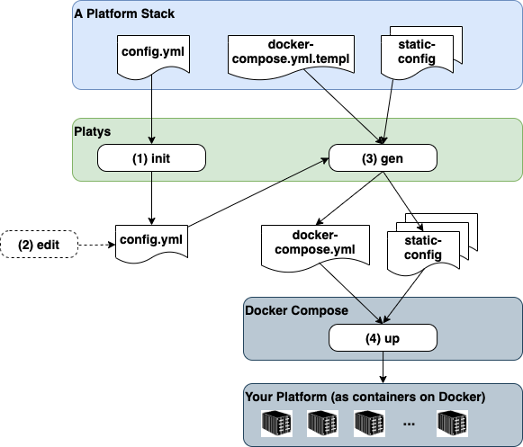
Trivadis platys – Data Platform in a Box
a toolset for generating and provisioning Modern Data Platforms based on Docker and Docker Compose
main use is for small-scale Data Lab projects, Proof-of-Concepts (PoC) or Proof-of-value (PoV) projects as well as trainings
A concrete Platform is always generated based on a given Platform Stack
See here for how to install platys
https://github.com/TrivadisPF/platys

Slide 3
Trivadis platys – How does it work?
Create a folder as your platform working directory
Initialize the platform using the platys init command
A config.yml file is created locally, holding all the possible options of the modern-data-platform 1.2.0 stack. See here for a documentation of the various options.
mkdir platys-demo
dd platys-demo
platys init -n platys-demo-platform -sn trivadis/platys-modern-data-platform -sv 1.2.0

Slide 4
Trivadis platys – How does it work?
Use an editor to set the needed services to true.
# Default values for the generator
# this file can be used as a template for a custom configuration
# or to know about the different variables available for the generator
platys:
platform-name: ‘platys-demo'
stack-image-name: 'trivadis/platys-modern-data-platform'
stack-image-version: '1.2.0'
# ===== Apache Zookeeper ========
KAFKA_enable: true
# one of enterprise, community
KAFKA_edition: 'community'
KAFKA_volume_map_data: false
KAFKA_broker_nodes: 3
KAFKA_delete_topic_enable: false
KAFKA_auto_create_topics_enable: false

Slide 5
Trivadis platys – How does it work?
Run platys gen to generate your platform
A folder with the name of the platform is created and in which all the artefacts for the Docker Compose stack can be found
Navigate into that folder and start the stack using docker-compose up
platys gen
cd platys-demo-platform
docker-compose up -d

Slide 6
Trivadis platys – Tips and Tricks
In the init you can also pass a list of services to directly set to true to omit having to edit the config.yml
You can list the available service of a given platform stack by using the list_services command
platys init -n platys-demo-platform -sn trivadis/platys-modern-data-platform -sv 1.2.0
-f -s KAFKA,SPARK,JUPYTER
platys list_services -sn trivadis/platys-modern-data-platform -sv 1.2.0

Slide 7
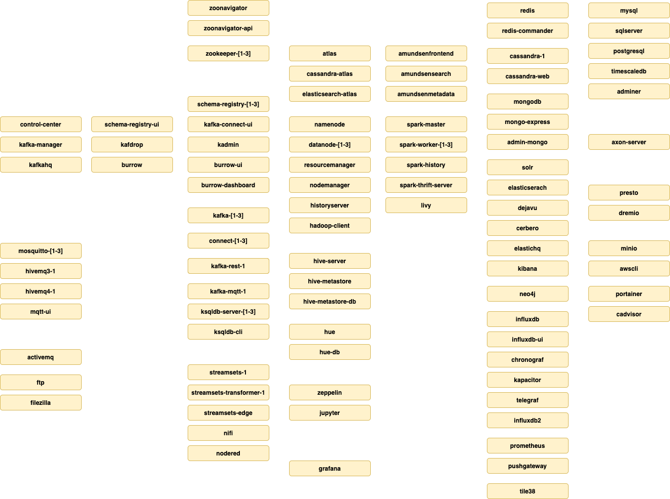
modern-data-platform – Service Overview

